Slide 1

Cloud Application Development

Slide 2
Outline
Design Considerations for Cloud Applications
Cloud Application Design Methodologies
Reference Architectures for Cloud Applications
Python Web Application Framework - Django

Slide 3
Design Considerations for Cloud Applications
Scalability
Reliability & Availability
Security
Maintenance & Upgradation
Performance

Slide 4
Design Considerations for Cloud Applications
Scalability
Scalability is an important factor that drives the application designers to move to cloud computing environments.
Building applications that can serve millions of users without taking a hit on their performance has always been challenging.
With the growth of cloud computing application designers can provision adequate resources to meet their workload levels.

Slide 5
Design Considerations for Cloud Applications
Reliability & Availability
Reliability of a system is defined as the probability that a system will perform the intended functions under stated conditions for a specified amount of time.
Availability is the probability that a system will perform a specified function under given conditions at a prescribed time.

Slide 6
Design Considerations for Cloud Applications
Security
Security is an important design consideration for cloud applications given the outsourced nature of cloud computing environments.

Slide 7
Design Considerations for Cloud Applications
Maintenance & Upgradation
To achieve a rapid time-to-market, businesses typically launch their applications with a core set of features ready and then incrementally add new features as and when they are complete.
In such scenarios, it is important to design applications with low maintenance and upgrade costs.

Slide 8
Design Considerations for Cloud Applications
Performance
Applications should be designed while keeping the performance requirements in mind.

Slide 9
Cloud application design methodologies
SOA
Service Oriented Architecture
MVC
Model View Controller
REST
Representative State Transfer
RESTful Web Services

Slide 10
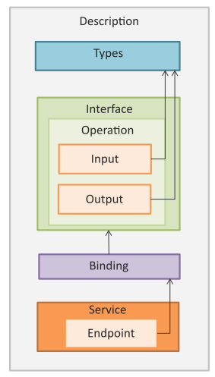
Service Oriented Architecture
Service Oriented Architecture (SOA) is a well established architectural approach for designing and developing applications in the form services that can be shared and reused.

Slide 11
Service Oriented Architecture
SOA is a collection of discrete software modules or services that form a part of an application and collectively provide the functionality of an application.

Slide 12
Service Oriented Architecture
SOA services are developed as loosely coupled modules with no hard-wired calls embedded in the services.
The services communicate with each other by passing messages.

Slide 13
Service Oriented Architecture
Services are described using the Web Services Description Language (WSDL).
WSDL is an XML-based web services description language that is used to create service descriptions containing information on the functions performed by a service and the inputs and outputs of the service.

Slide 14
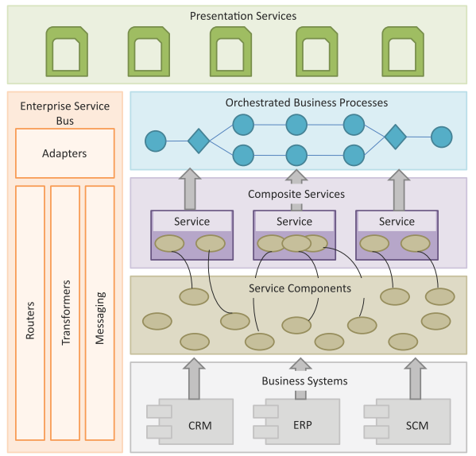
SOA Layers
Business Systems
Service Components
Composite Services
Orchestrated Business Processes
Presentation Services
Enterprise Service Bus

Slide 15
SOA Layers
Business Systems
This layer consists of custom built applications and legacy systems such as Enterprise Resource Planning (ERP), Customer Relationship Management (CRM), Supply Chain Management (SCM), etc.

Slide 16
SOA Layers
Service Components
The service components allow the layers above to interact with the business systems. The service components are responsible for realizing the functionality of the services exposed.

Slide 17
SOA Layers
Composite Services
These are coarse-grained services which are composed of two or more service components. Composite services can be used to create enterprise scale components or business-unit specific components.

Slide 18
SOA Layers
Orchestrated Business Processes
Composite services can be orchestrated to create higher level business processes. In this layers the compositions and orchestrations of the composite services are defined to create business processes.

Slide 19
SOA Layers
Presentation Services
This is the topmost layer that includes user interfaces that exposes the services and the orchestrated business processes to the users.

Slide 20
SOA Layers
Enterprise Service Bus
This layer integrates the services through adapters, routing, transformation and messaging mechanisms.

Slide 21
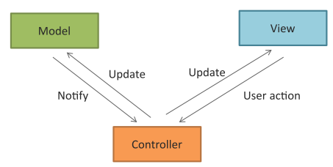
Model View Controller
Model View Controller (MVC) is a popular software design pattern for web applications.
Model
View
Controller

Slide 22
Model View Controller
Model View Controller (MVC) is a popular software design pattern for web applications.
Model
Model manages the data and the behavior of the applications. Model processes events sent by the controller. Model has no information about the views and controllers. Model responds to the requests for information about its state (from the view) and responds to the instructions to change state (from controller).

Slide 23
Model View Controller
Model View Controller (MVC) is a popular software design pattern for web applications.
View
View prepares the interface which is shown to the user. Users interact with the application through views. Views present the information that the model or controller tell the view to present to the user and also handle user requests and sends them to the controller.

Slide 24
Model View Controller
Model View Controller (MVC) is a popular software design pattern for web applications.
Controller
Controller glues the model to the view. Controller processes user requests and updates the model when the user manipulates the view. Controller also updates the view when the model changes.

Slide 25
RESTful Web Services
A RESTful web service is a web API implemented using HTTP and REST principles.
Representational State Transfer (REST) is a set of architectural principles by which you can design web services and web APIs that focus on a system’s resources and how resource states are addressed and transferred.
The REST architectural constraints apply to the components, connectors, and data elements, within a distributed hypermedia system.
The REST architectural constraints are as follows:
Client-Server
Stateless
Cacheable
Layered System
Uniform Interface
Code on demand

